Slide 1
Passing Arrays to Functions

Slide 2
Passing Arrays as Parameters
Arrays are always passed by reference.
The “[ ]” in the formal parameter specification indicates that the variable is an array.
It is a good practice to pass the dimension of the array as another parameter.
If the function must not change any element of the array then const should be used in the formal parameter specification of that array.

Slide 3
Smallest Value
Problem
  Find the smallest value in a list of integers
Input
  A list of integers and a value indicating the number of integers
Output
  Smallest value in the list
Note
  List remains unchanged after finding the smallest value!

Slide 4
Preliminary Design
Realizations
  When looking for value with distinguishing characteristics, need a way of remembering best candidate found so far
  Best written as a function - likely to be used often
Design
  Search array looking for smallest value
    Use a loop to consider each element in turn
    If current element is smallest so far, then update smallest value so far candidate
  When done examining all of the elements, the smallest value seen so far is the smallest value

Slide 5
Necessary Information
Information to be maintained
  Array with values to be inspected for smallest value
  Number of values in array
  Index of current element being considered
  Smallest value so far

Slide 6
A More Detailed Design
Solution:
  Function that takes two parameters: an integer array and the array size; returns smallest value
  Initialize smallest value to first element
  For each of the other elements in the array
    If it is smaller than the smallest value so far, update the value of the smallest value so far to current element
  Quit at end of array and return smallest value seen as value of the function

Slide 7
Passing An Array Example 3
Notice empty brackets
int ListMinimum(const int Ar[], int asize) {
  int SmallestValueSoFar = Ar[0];
  for (int i = 1; i < asize; ++i) {
    if (Ar[i] < SmallestValueSoFar ) {
      SmallestValueSoFar = Ar[i];
  }
  }
  return SmallestValueSoFar ;
}

Slide 8
Using ListMinimum
What happens with the following?
int Number[6] ={3, 88, -7, 9, 1, 24};
cout << ListMinimum(Number, 6) << endl;
int List[3];
List[0] = 9; List[1] = 12; List[2] = 45;
cout << ListMinimum(List, 3) << endl;

Slide 9
Some Useful Functions
void DisplayList(const int Ar[], int asize) {
  for (int index = 0; index < asize; ++index) {
    cout << Ar[index] << " ";
  }
  cout << endl;
}
void GetList(int Ar[], int size){
for (int index = 0; index < Size; index++) {
    cin >> Ar[index];
  }
}

Slide 10
Useful Functions Being Used
const int MaxSize = 25;
int Values[MaxSize];
GetList(Values,MaxSize );
DisplayList(Values, MaxSize);

Slide 11
Finding the Maximum element
Entire array is passed by reference through address of the first element and dimension of the array.
// Find the largest value in an array
// input: n - number of elements to check
// a[ ] - array of elements
// output:index to the largest element
#include <iostream.h>
int max_element(int size, const int a[]) {
int max_index = 0;
for (int i=1; i<size; i++)
if (a[i] > a[max_index])
max_index = i;
return max_index;
} // end max_element;

Slide 12
Finding the Maximum element
int main() {
int A[10] = {9,8,7,6,5,4,10,2,1,0};
cout << “The maximum element of this array is: ”
<< A[max_element(10,A)] << endl;
return 0;
}

Slide 13
//Example 1:passing array elements to a function
#include <iostream.h>
void print_square (int);
const int ARRAY_SIZE = 5;
int main(){
int index;
int base[ARRAY_SIZE] = {3, 7, 2, 4, 5};
for(index = 0; index < ARRAY_SIZE; index++)
print_square(base[index]);
cout << endl;
return 0;
}
void print_square(int number) {
cout << " " << number * number;
}

Slide 14
#include <iostream.h> //Example 2: passing a whole array
double average (int, const int[]);
int main(){
const int array_size = 5;
double ave;
int base[array_size] = {3, 7, 2, 4, 5};
ave = average(array_size, base);
cout << "The average of the numbers ";
cout << " is " << ave << endl;
return 0;
}

Slide 15
//Example 2: passing a whole array
double average( int size, const int inp_list[]) {
double sum = 0.0;
for ( int index = 0; index < size; index++)
sum += inp_list[index];
return sum/size;
}

Slide 16
Example 5
// Add a[i] and b[i] and store the sum in c[i]
void add_array(int size, // in: array size
double a[], // in: first array
double b[], // in: second array
double c[] ) // out: result array
// array elements with subscripts ranging from
// 0 to size-1 are added element by element
// Pre: a[i] and b[i] (0<=i<=size-1) are defined
// Post: c[i] = a[i] + b[i] (0<=i<=size-1)
{ int i;
// Add a[i] and b[i] and store result in c[i]
for (i=0; i < size; i++)
c[i] = a[i] + b[i];
}

Slide 17
Example 5
int main() {
const int size = 5;
double x[size] = {1.8, 2.2, 3.4, 5.1, 6.7},
y[size] = {2.0, 4.5, 1.3, 4.0, 5.5},
z[size];
int ind;
add_array(size , x, y, z);
cout << "Content of array z is: \n";
for (i = 0; i < size; i++)
cout << "z[" << i << "] is "
<< z[i] << endl;
return 0;
}

Slide 18
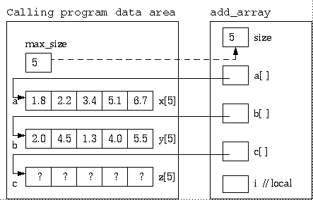
add_array (5, x, y, z );

Slide 19
Passing Two-Dimensional Arrays to Functions
You can pass a two-dimensional array to a function; however, C++ requires that the column size to be specified in the function declaration. Example 6 gives an example with a function that sum up two two-dimensional array into a third one.

Slide 20
Example 6
// Sum up two 2-dimensional arrays into a third one
#include <iostream>
using namespace std;
const int max_cols = 5;
// c[i][j] = a[i][j] + b[i][j]
void add_array(double a[][max_cols],
double b[][max_cols],
double c[][max_cols],
int rows)
{ int i, j;
for (i=0; i < rows; i++)
for (j=0; j < max_cols; j++)
c[i][j] = a[i][j] + b[i][j];
}

Slide 21
int main() {
const int max_rows = 2;
double a[max_rows][max_cols] = {{1.8, 2.2, 3.4, 5.1, 6.7},
{1.0, 2.0, 3.0, 5.0, 6.0}},
b[max_rows][max_cols] = {{0.2, -0.2, -1.4, -3.1, -4.7},
{1.0, 0.0, -1.0, -3.0, -4.0}},
c[max_rows][max_cols];
int i, j;
add_array(a, b, c, max_rows);
// fix how decimals are shown
cout.setf(ios::fixed); // use decimal notation
cout.setf(ios::showpoint); // show decimals
cout.precision(1); // one decimal place
cout << "Content of array c is: \n";
for (i = 0; i < max_rows; i++){
for (j=0; j < max_cols; j++)
cout << c[i][j] << ", ";
cout << endl;
}
return 0;
}

Slide 22
Pass-by-Reference
void m(int, int []);
int main()
{
int x = 1; // x represents an int value
int y[10]; // y represents an array of int values
y[0] = 1; // Initialize y[0]
m(x, y); // Invoke m with arguments x and y
cout << "x is " << x << endl;
cout << "y[0] is " << y[0] << endl;
return 0;
}
void m(int number, int numbers[])
{
number = 1001; // Assign a new value to number
numbers[0] = 5555; // Assign a new value to numbers[0]
}

Slide 23
Reverse function
void reverse(const int list[], int newList[], int size)
{
for (int i = 0, j = size - 1; i < size; i++, j--)
{
newList[j] = list[i];
}
}
int main(){
int list1[5] = {1, 2 , 4, 5, 6};
int list2[5];
reverse(list1, list2 ,5);
return 0;
}
list
1
2
3
4
5
6
newList
6
5
4
3
2
1

Slide 24
Reverse function
void add_array( double a[], // in: first array
int size_a,
double b[], // in: second array
int size_b,
double c[],
int size_c) // out: result array
//c[i] = a[i] + b[i]
{
for (int i = 0; i < size_c; i++)
c[i] = 0;
for (int i=0; i < size_a && i <size_c; i++)
c[i] += a[i];
for (int i=0; i < size_b && i <size_c; i++)
c[i] += b[i];
}
int main()
{
double a[5] = {1,2,3,4,5};
double b[3] = {100,200,300};
double c[10];
add_array(a,5,b,3,c,10);
for (int i = 0; i < 10; i++)
cout << c[i] << endl;
return 0;
}
list
1
2
3
4
5
6
newList
6
5
4
3
2
1

Slide 25
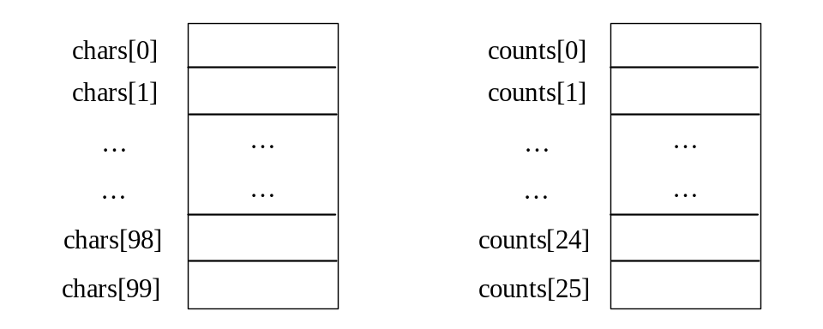
Problem: Counting Occurrence of Each Letter
Generate 100 lowercase letters randomly and assign to an array of characters.
Count the occurrence of each letter in the array.
//CountLettersInArray.cpp

